Slide 1
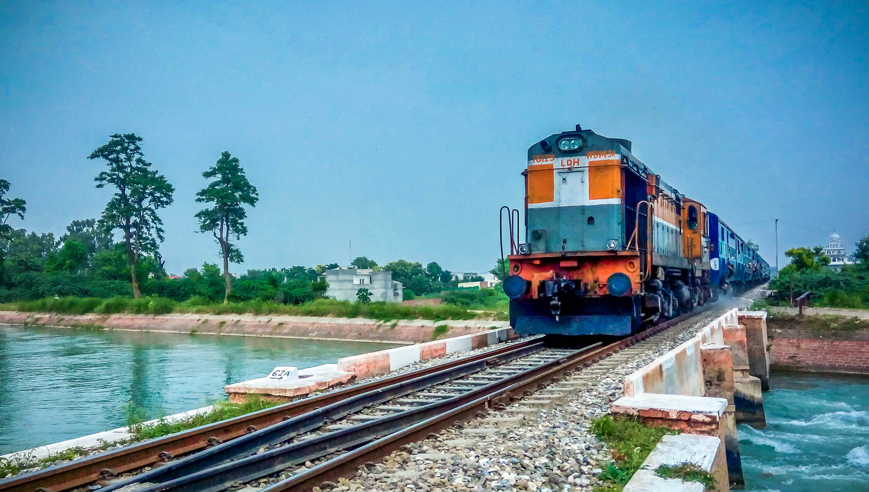
railWAY TRACK MONITORING SYSTEM - railway revolution
tracks that talks lives that matter

Slide 2



RAILWAY REVOLUTION
Problem Statement - AI based development of Laser
based QR Code marking on track fittings on Indian Railways.
Theme: INDIAN RAILWAY REVOLUTION
Mentor : DR.M.N.A.Gulshan Taj
Industrial Mentor : Mr.Mariyam Michel
(PRO Salem Divisional Railway)

Slide 3
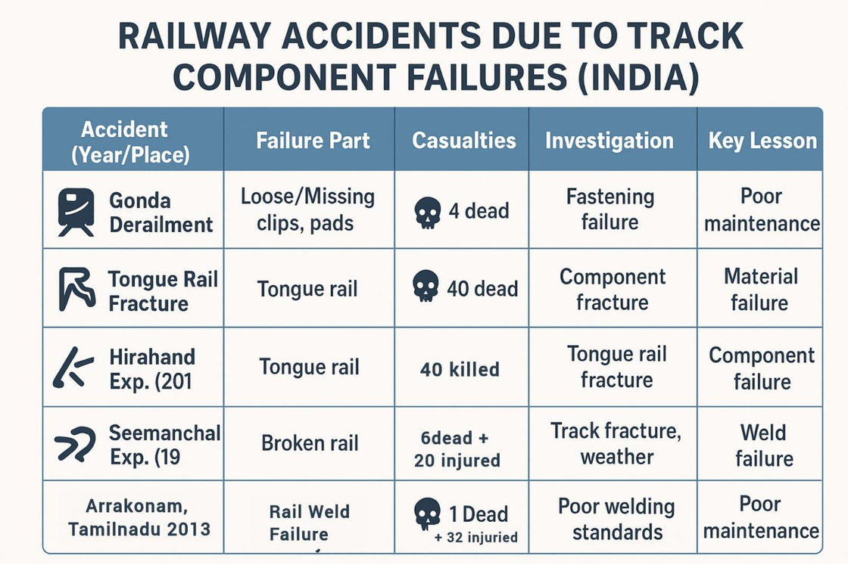
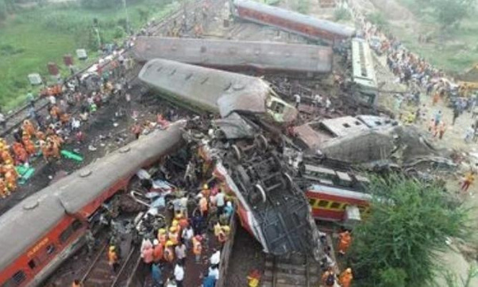






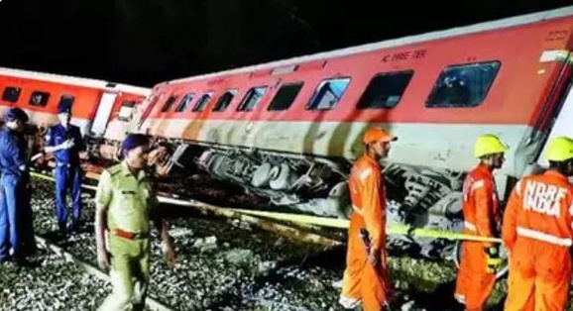







Why Smarter Track Monitoring is Urgently Needed?
Hidden Weaknesses,VisibleTragedies !!
40 dead &
97 injuried
ECONOMICAL
LOSS ₹25-₹30 CR.
Hirahand Express ,Andrapadesh 2017
GondaDerailment,UttraPradesh 2024
4 Dead & 64
injuried
ECONOMICAL
LOSS ₹10-20 CR.
2

Slide 4

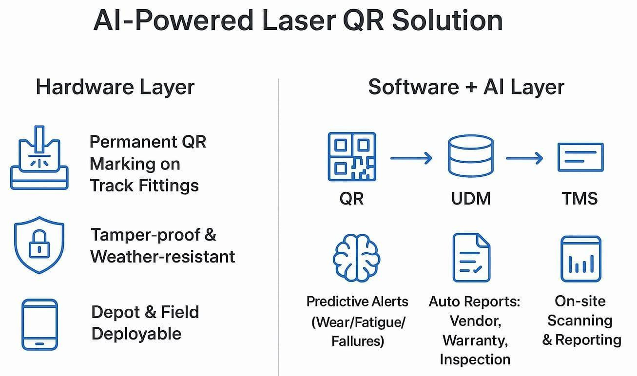
PROPOSED SOLUTION
TracksThatTalk : AI+QR+Laser=RailwayRevolution
3

Slide 5

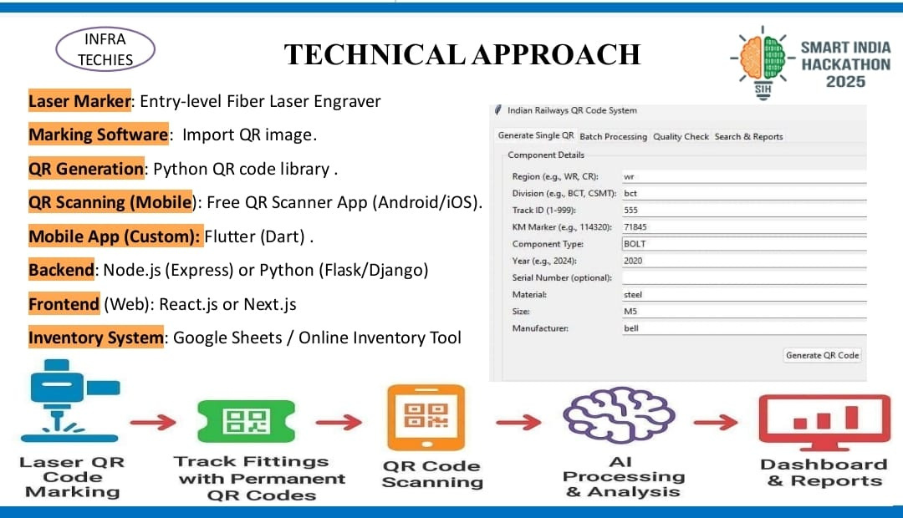
TECHNOLOGICAL APPROACH

Slide 6
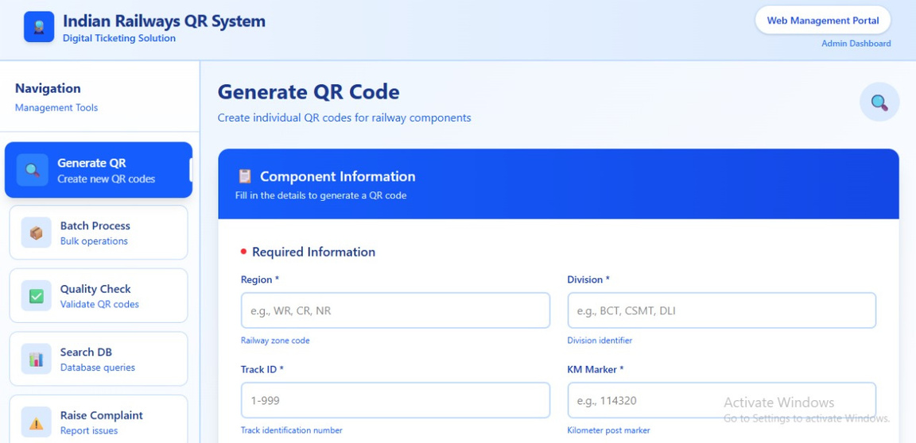
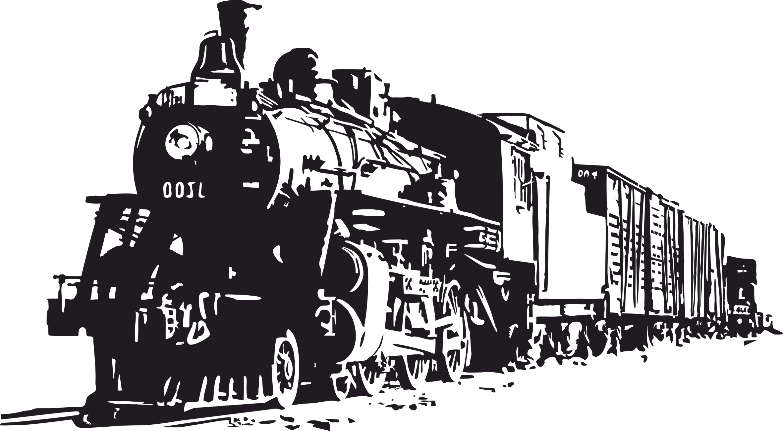

SYSTEM FRONTEND - REAL TIME OUTPUT
USER INTERFACE & DASHBOARD PREVIEW

Slide 7
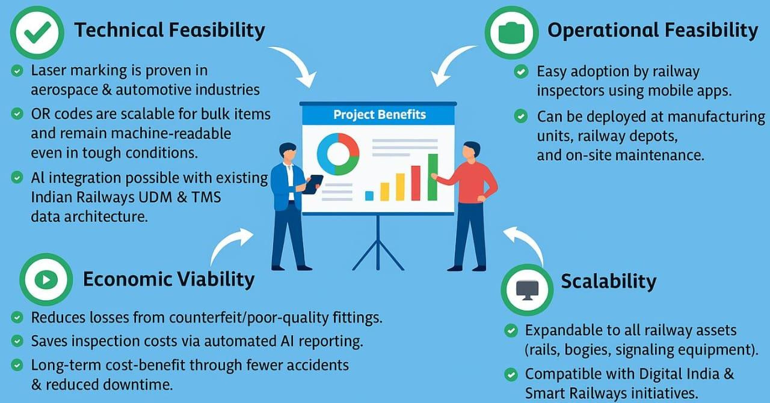
FEASIBILITY AND VIABILITY
5

Slide 8
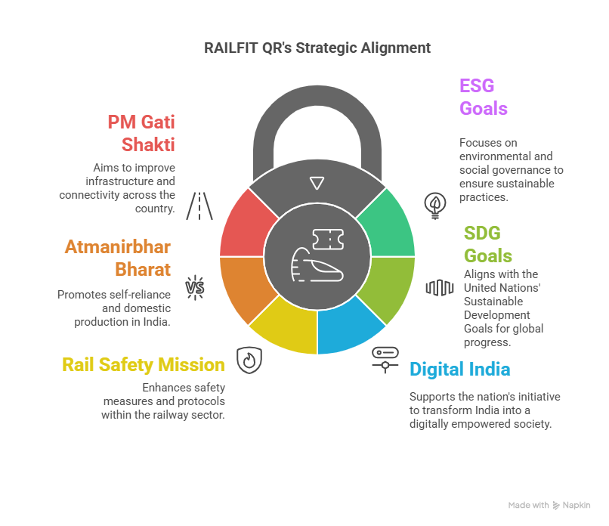



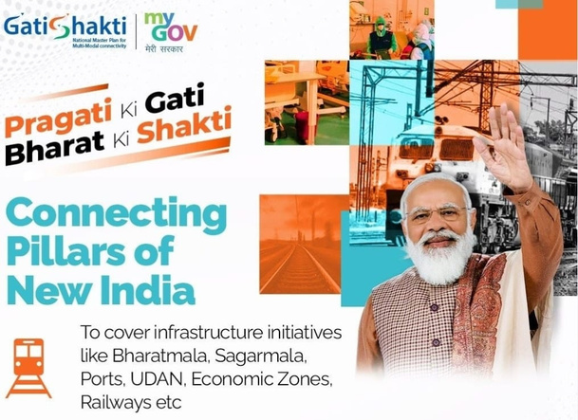
RAILFIT QR’S STRATEGIC ALIGNMENT

Slide 9
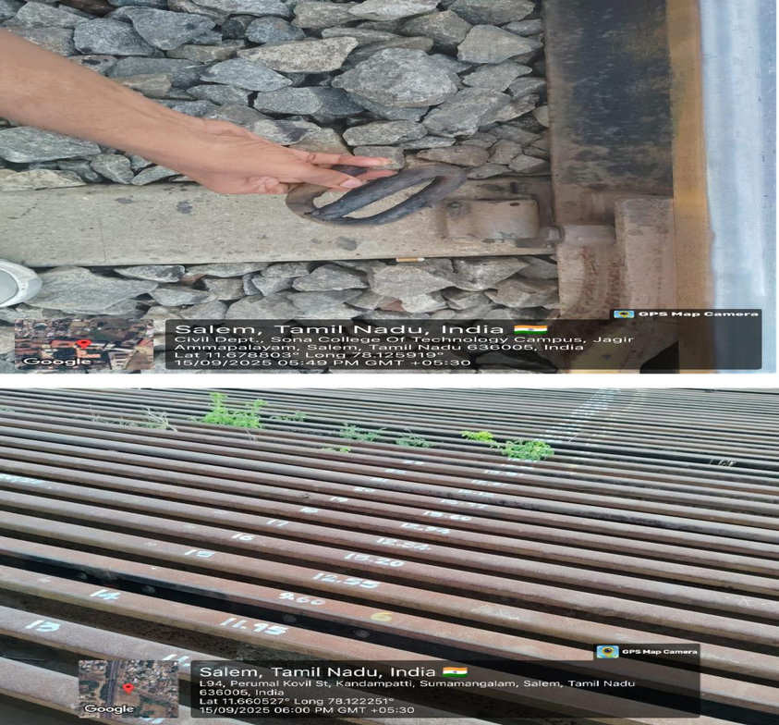

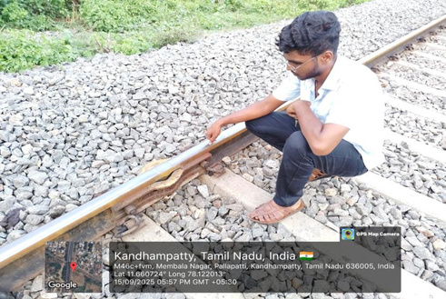
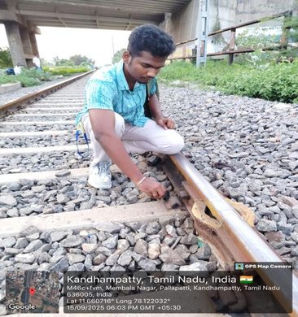
FIELD STUDY & ON-SITE VALIDATION
Physical inspection of track components
& fiittings.
Failure patterns and maintenance practices.
Solution validated under real condition.
At Kandhampattyrailway track,Salem.
6

Slide 10

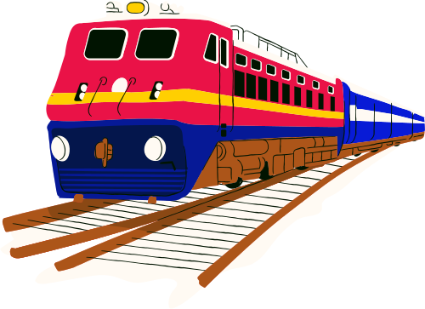
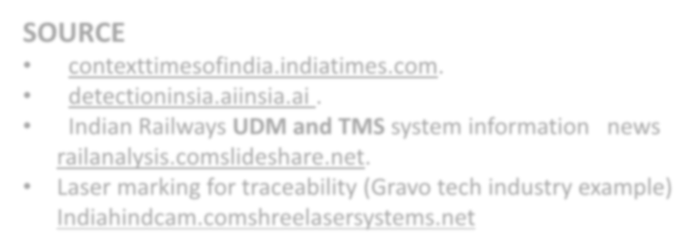

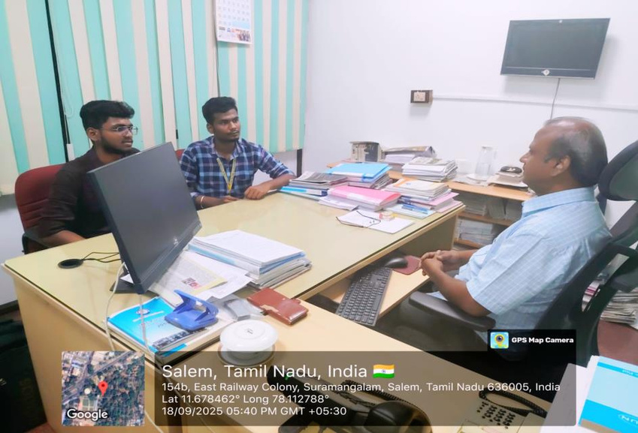
RESEARCH AND REFERENCES
SOURCE
• • •
•
contexttimesofindia.indiatimes.com.
detectioninsia.aiinsia.ai .
Indian Railways UDM and TMS system information news railanalysis.comslideshare.net. Laser marking for traceability (Gravo tech industry example) Indiahindcam.comshreelasersystems.net
• Met Salem Divisional Railway PRO to discuss our solution overview. Conductedreal-time analysis at Kandhampatty track to refine our system design.
7

Slide 11
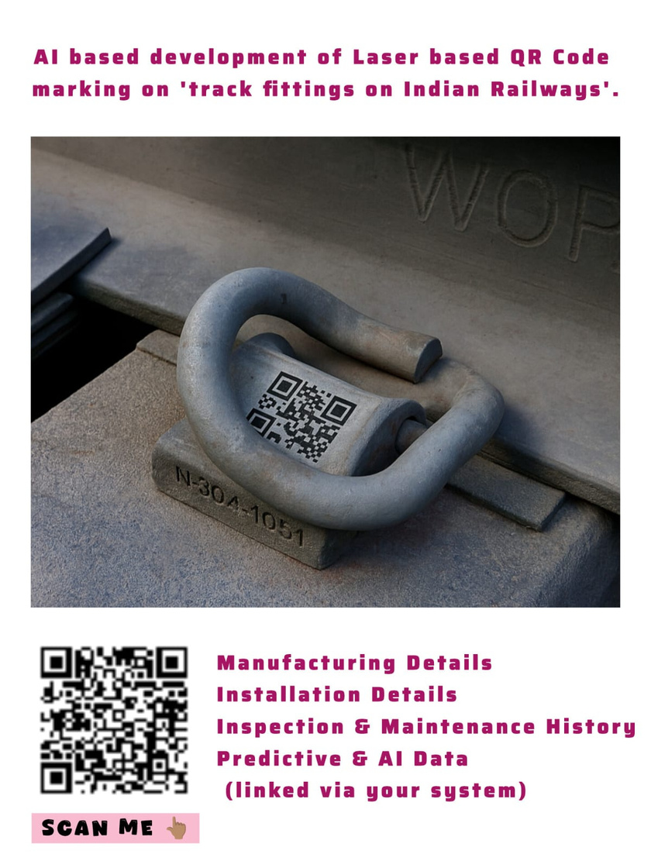
FINAL OUTPUT OF THE PROPOSED SYSTEM

Slide 12

Thank
You
-INFRA TECHIES

